Slide 1
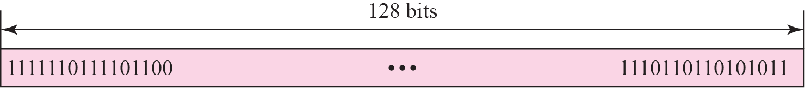
26-1 INTRODUCTION
An IPv6 address is 128 bits or 16 bytes (octet) long.
The address length in IPv6 is four times of the length address in IPv4.
TCP/IP Protocol Suite

Slide 2
Rationale for Change
Larger address space. An IPv6 address is 128 bits long.
Better header format. IPv6 uses a new header format in which options are separated from the base header and inserted, when needed. This simplifies and speeds up the routing process.
 New options. IPv6 has new options to allow for additional functionalities.
 
Allowance for extension. IPv6 is designed to allow the extension of the protocol if required by new technologies or applications.
Support for resource allocation. In IPv6, the type-of-service field has been removed, but two new fields, traffic class and flow label have been added to enable the source to request special handling of the packet. This mechanism can be used to support traffic such as real-time audio and video.
Support for more security. The encryption and authentication options in IPv6 provide confidentiality and integrity of the packet.
TCP/IP Protocol Suite

Slide 3
Figure 26.2 Colon hexadecimal notation
Notations :
Dotted decimal notation
Colon hexadecimal notation
TCP/IP Protocol Suite

Slide 4
Figure 26.2 Colon hexadecimal notation
Notations :
Colon hexadecimal notation
The leading zeros of a section can be omitted.
0074 can be written as 74, 000F as F, and 0000 as 0.
TCP/IP Protocol Suite

Slide 5
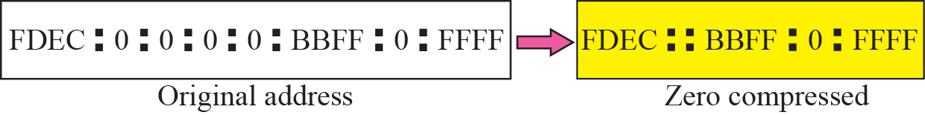
Figure 26.3 Zero compression
if there are consecutive sections consisting of zeros only, we can remove all the zeros altogether and replace them with a double semicolon.
Note that this type of abbreviation is allowed only once per address. If there are two runs of zero sections, only one of them can be compressed.
TCP/IP Protocol Suite

Slide 6
Mixed Representation
TCP/IP Protocol Suite

Slide 7

Figure 26.4 CIDR address
CIDR Notation
TCP/IP Protocol Suite

Slide 8
Example 26.1
Show the unabbreviated colon hex notation for the following IPv6 addresses:
a. An address with 64 0s followed by 64 1s.
b. An address with 128 0s.
c. An address with 128 1s.
d. An address with 128 alternative 1s and 0s.
Solution
a. 0000:0000:0000:0000:FFFF:FFFF:FFFF:FFFF
b. 0000:0000:0000:0000:0000:0000:0000:0000
c. FFFF:FFFF:FFFF:FFFF:FFFF:FFFF:FFFF:FFFF
d. AAAA:AAAA:AAAA:AAAA:AAAA:AAAA:AAAA:AAAA
TCP/IP Protocol Suite

Slide 9
Example 26.2
The following shows the zero contraction version of addresses (part c and d cannot be abbreviated)
a. An address with 64 0s followed by 64 1s.
b. An address with 128 0s.
c. An address with 128 1s.
d. An address with 128 alternative 1s and 0s.
a. :: FFFF:FFFF:FFFF:FFFF
b. ::
c. FFFF:FFFF:FFFF:FFFF:FFFF:FFFF:FFFF:FFFF
d. AAAA:AAAA:AAAA:AAAA:AAAA:AAAA:AAAA:AAAA
TCP/IP Protocol Suite

Slide 10
Example 26.3
Show abbreviations for the following addresses:
a. 0000:0000:FFFF:0000:0000:0000:0000:0000
b. 1234:2346:0000:0000:0000:0000:0000:1111
c. 0000:0001:0000:0000:0000:0000:1200:1000
d. 0000:0000:0000:0000:0000:FFFF:24.123.12.6
Solution
a. 0:0:FFFF::
b. 1234:2346::1111
c. 0:1::1200:1000
d. ::FFFF:24.123.12.6
TCP/IP Protocol Suite

Slide 11
Example 26.4
Decompress the following addresses and show the complete unabbreviated IPv6 address:
a. 1111::2222
b. ::
c. 0:1::
d. AAAA:A:AA::1234
Solution
a. 1111:0000:0000:0000:0000:0000:0000:2222
b. 0000:0000:0000:0000:0000:0000:0000:0000
c. 0000:0001:0000:0000:0000:0000:0000:0000
d. AAAA:000A:00AA:0000:0000:0000:0000:1234
TCP/IP Protocol Suite

Slide 12
Example 26.5
To give some idea about the number of addresses, let us assume that the number of people on the planet earth is soon to be 2³⁴ (more than 16 billion). Each person can have 2⁹⁴ addresses to use.
If we assign 2⁶⁰ addresses to the users each year (almost one billion each second), it takes 2⁶⁸ years to deplete addresses.
If we can build a high-rise building over the land and sea to accommodate 2⁶⁸ computers in each square meter of the earth, still there are enough addresses to connect all computers to the Internet (the planet earth is approximately 2⁶⁰ square meters).
TCP/IP Protocol Suite

Slide 13
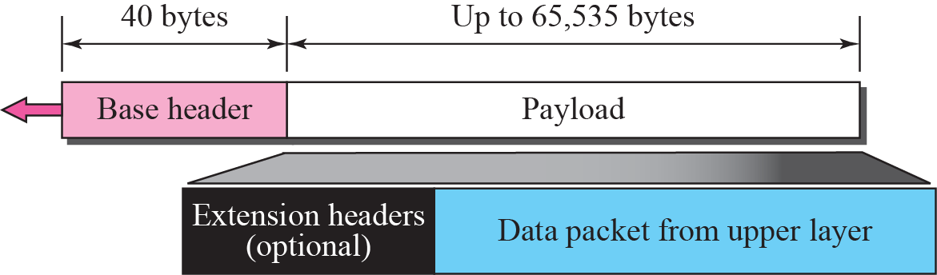
27-2 PACKET FORMAT
Each packet is composed of a mandatory base header followed by the payload.
Payload consists of 2 parts: optional extension headers and data from an upper layer.
The base header occupies 40 bytes, whereas the extension headers and data from the upper layer contain up to 65,535 bytes of information.
TCP/IP Protocol Suite

Slide 14
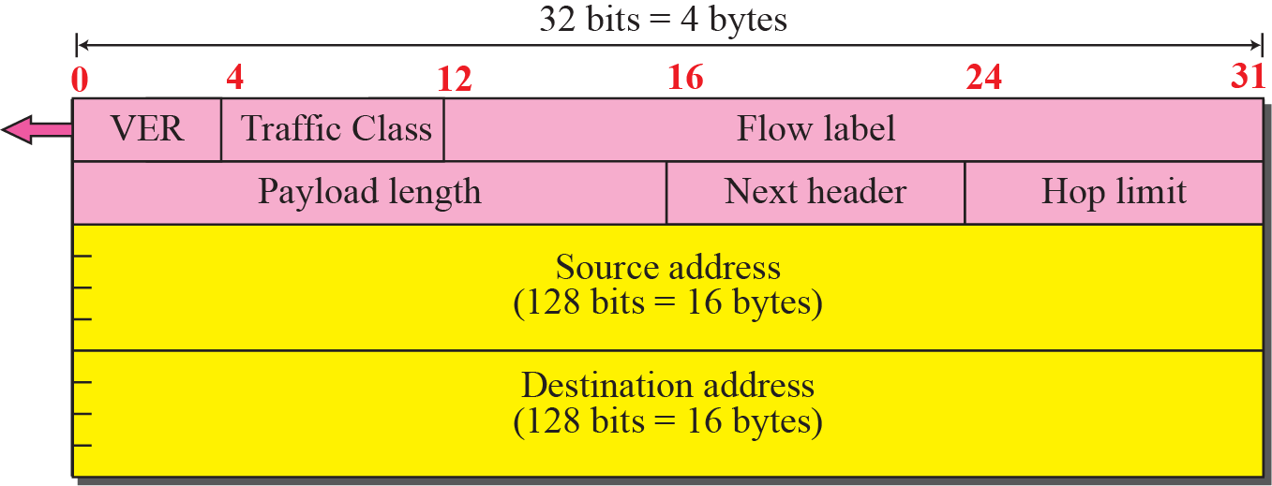
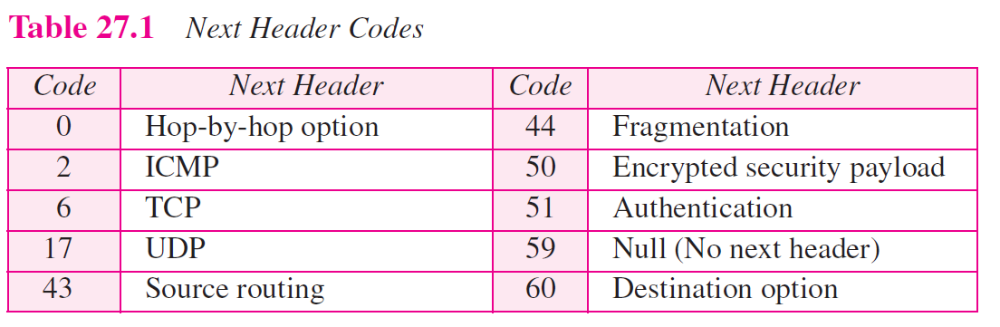
TCP/IP Protocol Suite

Slide 15
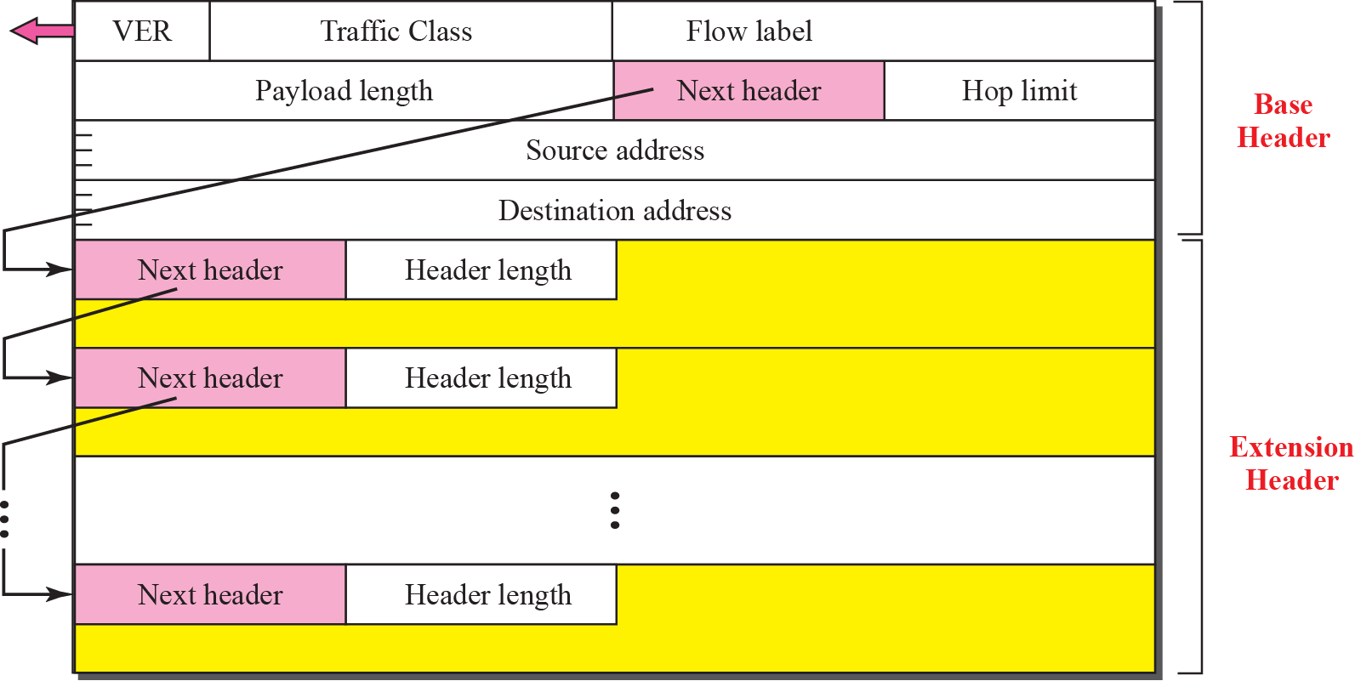
TCP/IP Protocol Suite

Slide 16
Example : Fragmentation Header
TCP/IP Protocol Suite

Slide 17
27-3 TRANSITION FROM IPv4 TO IPv6
Because of the huge number of systems on the Internet, the transition from IPv4 to IPv6 cannot happen suddenly.
It will take a considerable amount of time before every system in the Internet can move from IPv4 to IPv6.
The transition must be smooth to prevent any problems between IPv4 and IPv6 systems.
Three strategies have been devised by the IETF to help the transition (see Figure 27.16).
TCP/IP Protocol Suite

Slide 18
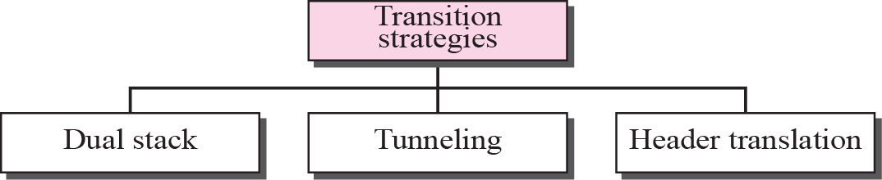
Figure 27.16 Three transition strategies
TCP/IP Protocol Suite

Slide 19
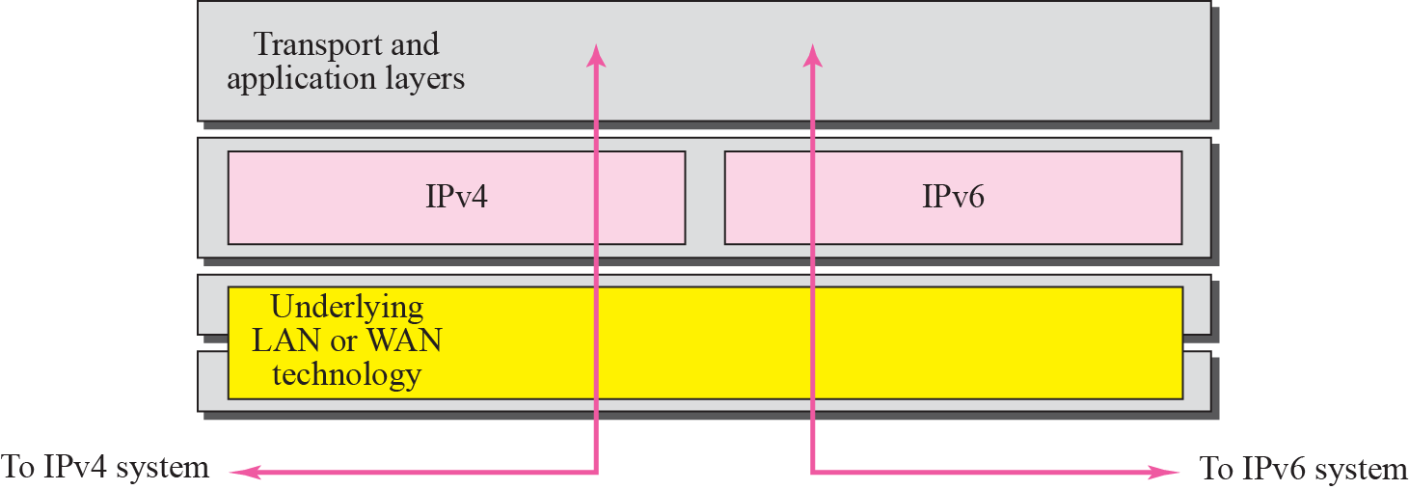
Figure 27.17 Dual stack
TCP/IP Protocol Suite

Slide 20
Figure 27.17 Dual stack
It is recommended that all hosts, before migrating completely to version 6, have a dual stack of protocols.
station must run IPv4 and IPv6 simultaneously until all the Internet uses IPv6.
To determine which version to use when sending a packet to a destination, the
source host queries the DNS.
If the DNS returns an IPv4 address, the source host sends an IPv4 packet.
If the DNS returns an IPv6 address, the source host sends an IPv6 packet.
TCP/IP Protocol Suite

Slide 21
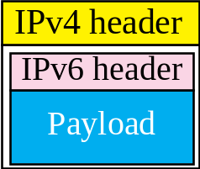
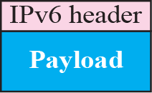
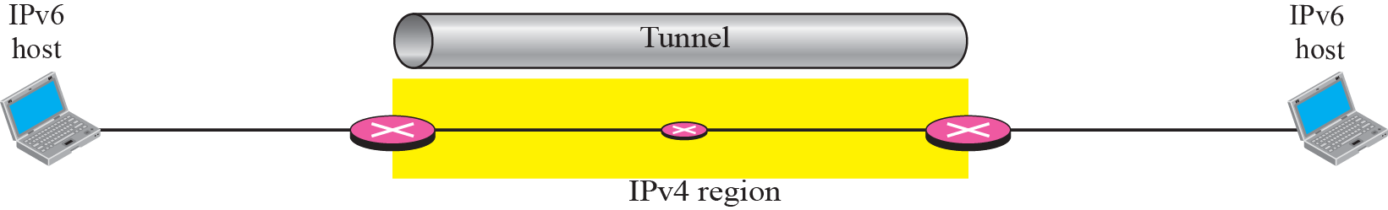
Figure 27.18 Tunneling strategy
TCP/IP Protocol Suite

Slide 22
Figure 27.18 Tunneling strategy
Tunneling is a strategy used when two computers using IPv6 want to communicate with each other and the packet must pass through a region that uses IPv4.
To pass through this region, the packet must have an IPv4 address.
So the IPv6 packet is encapsulated in an IPv4 packet when it enters the region, and it leaves its capsule when it exits the region.
It seems as if the IPv6 packet goes through a tunnel at one end and emerges at the other end.
To make it clear that the IPv4 packet is carrying an IPv6 packet as data, the protocol value is set to 41.
TCP/IP Protocol Suite

Slide 23
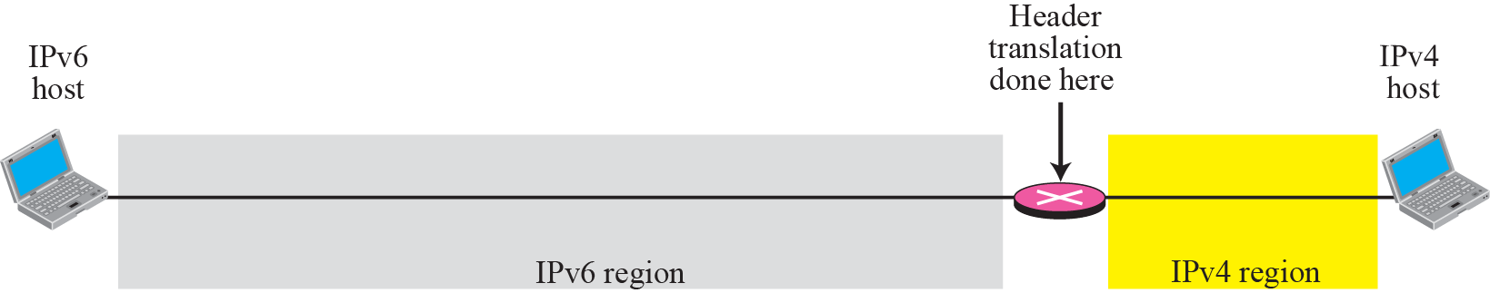
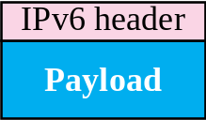
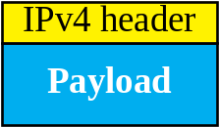
Figure 27.19 Header translation strategy
TCP/IP Protocol Suite

Slide 24
Figure 27.19 Header translation strategy
Header translation is necessary when the majority of the Internet has moved to IPv6 but some systems still use IPv4.
The sender wants to use IPv6, but the receiver does not understand IPv6.
Tunneling does not work in this situation because the packet must be in the IPv4 format to be understood by the receiver.
In this case, the header format must be totally changed through header translation. The header of the IPv6 packet is converted to an IPv4 header (see Figure 27.19).
TCP/IP Protocol Suite

